Slide 1
Home Depot Product Search Relevance
A competition by
Mohammed Alharbi & Yixuan Edison Wang
April 18th, 2016

Slide 2
Outline
Data Exploration
Tackling the Problem
Fitting Models
Conclusion

Slide 3
Data Exploration

Slide 4
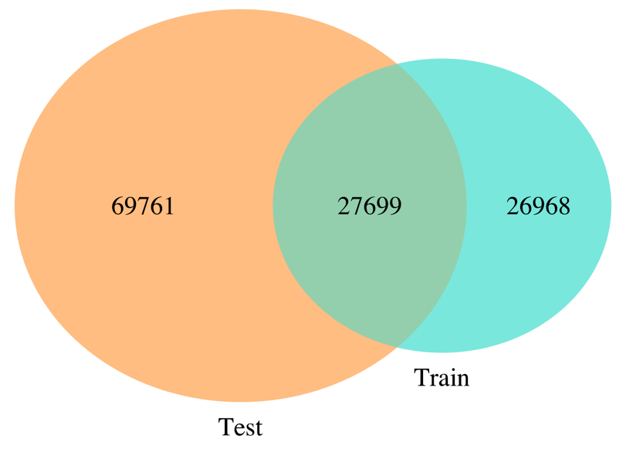
Product IDs
A Venn Diagram of product ids in both Test and Train

Slide 5
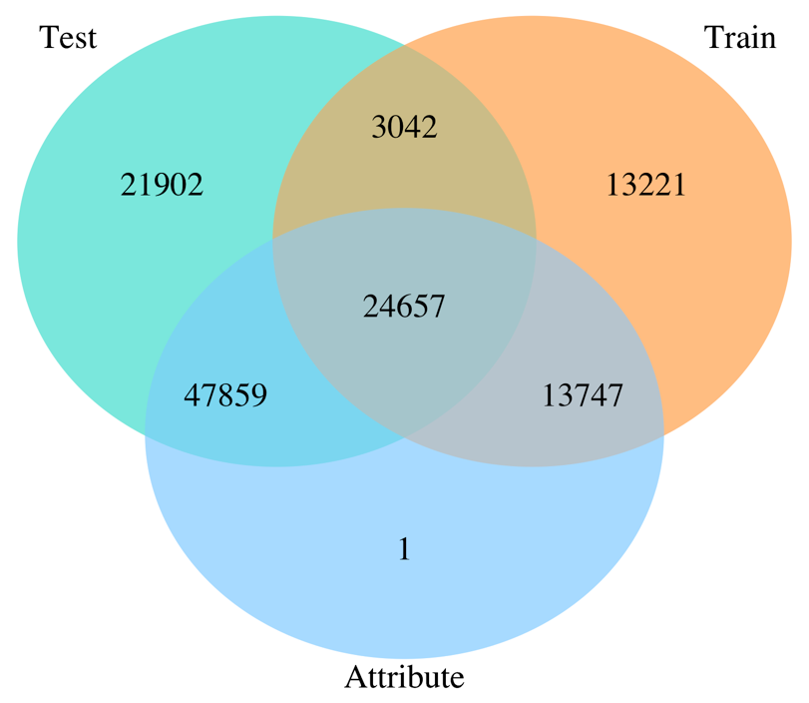
Product IDs
A Venn Diagram of product ids in the train, test, and attributes files
155 rows

Slide 6
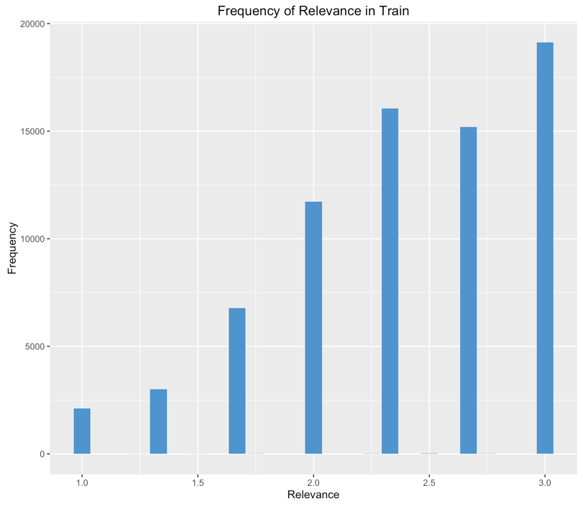
Relevance Values
In Train data, there are a total of 13 unique relevance values.

Slide 7
Attributes data
63 names refer to a color aspect.
Attribute’s Name | Frequency
color family | 41,508
color/finish | 28,564
color | 6,222
color/finish family | 4,630
fixture color/finish | 4,119
fixture color/finish family | 2,256
shade color family | 2,006
actual color temperature (k) | 1,421
color rendering index | 1,118
top color family | 996
C O L O R

Slide 8
Attributes data
10 names refer to brand aspect.
Attribute’s Name | Frequency
mfg brand name | 86,250
brand/model compatibility | 681
brand compatibility | 609
fits faucet brand | 550
fits brands | 407
fits brand/models | 168
fits brands/models | 119
pump brand | 87
fits brand/model | 6
brand/model/year compatibility | 4
B R A N D

Slide 9
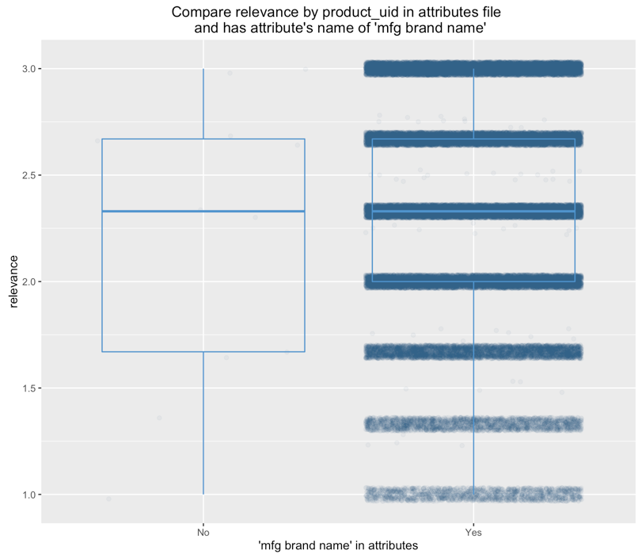
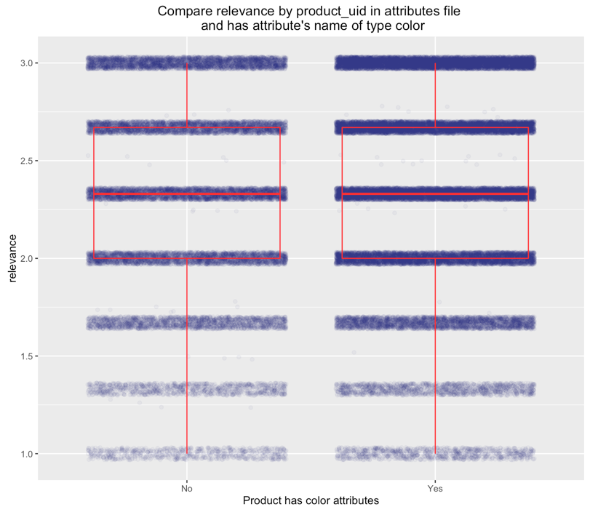
Importance of Brand vs. Color

Slide 10
Tackling the Problem
Basic Structure

Slide 11
Splitting data
Attributes
test.csv
train.csv
Pick some/all attributes
Clean up
Merging data
Clean up
att.csv
brand, color
Computing attributes
Fitting Model
desc.csv
Clean up Phase 2
Length of words
FOR ALL: [search_term, title, desc, brand, colors]
Query in title/desc
Query last word in title/desc
Prediction
Spelling checker 1
Word in title/desc
Normalizing
Ratio title
Spelling checker 2
Ratio description
RMSE
Steeming
Word in brand
Ratio brand
Brand feature
Save data
Basic Structure
Search term feature

Slide 12
Programming Language

Slide 13
Fitting Models

Slide 14
Models
Linear Regression.
Random Forests.
Generalized Boosted Model (GBM).

Slide 15
Outcomes
 | Model | num.tree | product_uid | len_of_query | len_of_title | len_of_description | len_of_brand | len_of_color | query_in_title | query_in_description | query_last_word_in_title | query_last_word_in_description | word_in_title | word_in_description | ratio_title | ratio_description | word_in_brand | ratio_brand | brand_feature | search_term_feature | importance (permutation) | distribution | shrinkage | interaction.depth | n.minobsinnode | RMSE (train) | RMSE (test)
1 | LR | NA | 1 | 1 | 1 | 1 | 1 | 1 | 1 | 1 | 1 | 1 | 1 | 1 | 1 | 1 | 1 | 1 | 1 | 1 | NA | NA | NA | NA | NA | 0.4838606 | 0.48604
1 | GBM | 6000 | 1 | 1 | 1 | 1 | 1 | 1 | 1 | 1 | 1 | 1 | 1 | 1 | 1 | 1 | 1 | 1 | 1 | 1 | NA | gaussian | 0.01 | 3 | 10 | 0.4720986 | 0.47862
2 | GBM | 6000 | 1 | 1 | 1 | 1 | 1 | 1 | 1 | 1 | 1 | 1 | 1 | 1 | 1 | 1 | 1 | 1 | 1 | 1 | NA | gaussian | 0.05 | 3 | 10 | 0.4727213
3 | GBM | 500 | 1 | 1 | 1 | 1 | 1 | 1 | 1 | 1 | 1 | 1 | 1 | 1 | 1 | 1 | 1 | 1 | 1 | 1 | NA | gaussian | 0.008 | 5 | 10 | 0.4701253 | 0.47818
4 | GBM | 3000 | 1 | 1 | 1 | 1 | 1 | 1 | 1 | 1 | 1 | 1 | 1 | 1 | 1 | 1 | 1 | 1 | 1 | 1 | NA | gaussian | 0.006 | 7 | 8 | 0.468994 | 0.47798
5 | GBM | 3000 | 1 | 1 | 1 | 1 |  | 1 | 1 | 1 | 1 | 1 | 1 | 1 | 1 | 1 |  | 1 | 1 | 1 | NA | gaussian | 0.006 | 7 | 8 | 0.4703201
6 | GBM | 3000 | 1 | 1 | 1 | 1 |  | 1 | 1 | 1 | 1 | 1 | 1 |  | 1 | 1 |  | 1 | 1 | 1 | NA | gaussian | 0.006 | 7 | 8 | 0.4702524
7 | GBM | 3000 | 1 | 1 | 1 | 1 |  | 1 |  |  | 1 |  |  |  | 1 | 1 |  |  | 1 | 1 | NA | gaussian | 0.006 | 7 | 8 | 0.4705538
8 | GBM | 3000 | 1 | 1 | 1 | 1 |  | 1 |  |  | 1 |  |  |  | 1 | 1 |  |  | 1 | 1 | NA | gaussian | 0.006 | 7 | 5 | 0.4702829 | 0.47843
9 | GBM | 6000 | 1 | 1 | 1 | 1 | 1 | 1 | 1 | 1 | 1 | 1 | 1 | 1 | 1 | 1 | 1 | 1 | 1 | 1 | NA | gaussian | 0.01 | 7 | 10 | 0.4687573 | 0.47802
10 | GBM | 6000 | 1 | 1 | 1 | 1 | 1 | 1 | 1 | 1 | 1 | 1 | 1 | 1 | 1 | 1 | 1 | 1 | 1 | 1 | NA | gaussian | ? | ? | ? | ? | 0.47626
1 | RF | 500 | 1 | 1 | 1 | 1 | 1 | 1 | 1 | 1 | 1 | 1 | 1 | 1 | 1 | 1 | 1 | 1 | 1 | 1 | 1 | NA | NA | NA | NA | 0.5292541
2 | RF | 2500 | 1 | 1 | 1 | 1 | 1 | 1 | 1 | 1 | 1 | 1 | 1 | 1 | 1 | 1 | 1 | 1 | 1 | 1 | 1 | NA | NA | NA | NA | 0.2749385 | 0.48069
3 | RF | 2500 |  |  |  |  |  |  | 1 | 1 |  |  |  | 1 | 1 |  | 1 |  |  |  | 1 | NA | NA | NA | NA | 0.5069339
4 | RF | 2500 | 1 |  |  |  |  |  | 1 | 1 |  |  |  | 1 | 1 |  | 1 |  |  |  | 1 | NA | NA | NA | NA | 0.4870805
5 | RF | 4000 | 1 | 1 | 1 | 1 |  | 1 |  |  | 1 |  |  |  | 1 | 1 |  |  | 1 | 1 | 1 | NA | NA | NA | NA | 0.253911 | 0.48265

Slide 16
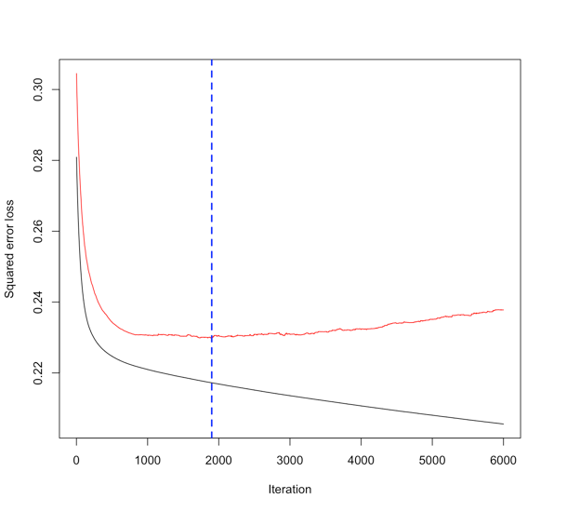
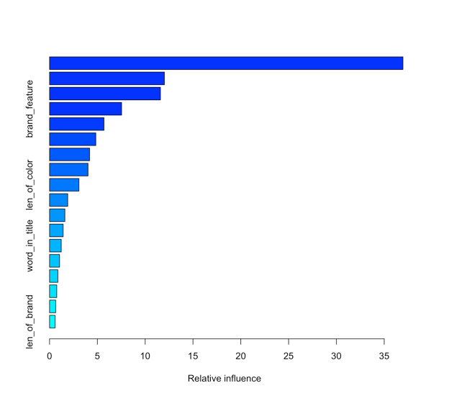
RMSE (train) = 0.4687573
A plot of GBM performance
A plot of the relative influence of each variable

Slide 17
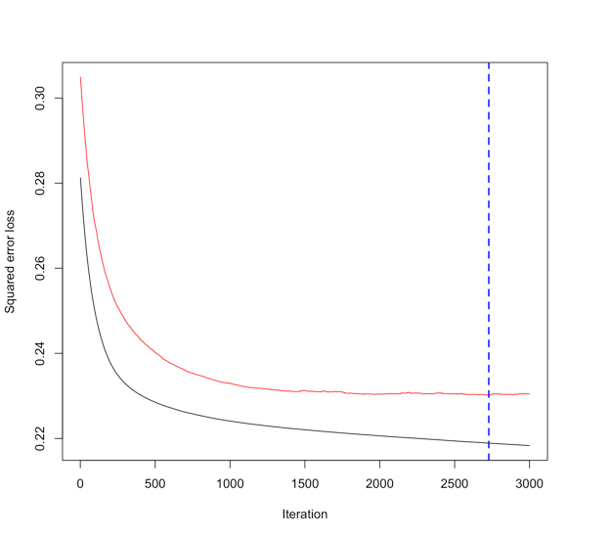
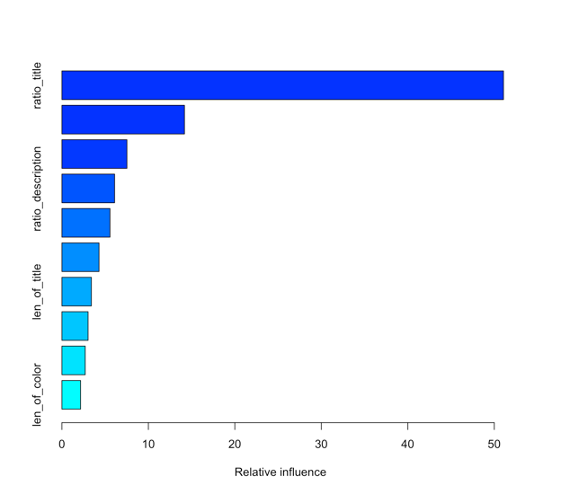
RMSE (train) = 0.4702829
A plot of GBM performance
A plot of the relative influence of each variable

Slide 18
Which One Is Better?
RMSE (test): 0.47843
RMSE (test): 0.47802

Slide 19

Ranking in the Competition

Slide 20
Conclusion

